Slide 1
Why I Invest in Non-Performing Notes… And Why You Should Too!
Terrence Evans, Managing Member
Notes:
Hello and welcome everyone. Thanx for taking some time out of your busy morning/afternoon to attend this webinar.
Today’s discussion is called “Why I invest in Non performing notes and why you should too”
My name is Terrence Evans, managing member of Terreva Investments. So let’s get started.

Slide 2
Agenda
Introduction
Overview
Note Investing
Non-Performing Note Investing
Real Life Examples
Wrapping Up
Q&A

Slide 3
Introduction
Purpose of this Presentation, Who Am I?

Slide 4
Introduction
What it is intended to be:
An informational overview of how 1st position, non-performing note investing can be superior to other forms of investing
What it isn’t intended to be:
To inform you of some get-rich-quick scheme.. You would be sadly disappointed
A MBA-level explanation of this business
A sales pitch
Purpose of this Presentation
Notes:
A sales pitch. So I’m not a guru. I will not at the end of this presentation try to upsell you a program, e-book, CDs, DVDs, website access, or what-have-you for the low low price of $999. The purpose of this is informational. What everyone does with this information at the conclusion is up to them.

Slide 5
Introduction
Originally from the Atlanta area
Los Angeles area resident, practicing Electrical Engineer for 20+ years
Have twin daughters, Tori and Addison
Terrence
Terrence L. Evans
About the Presenter
Notes:
Start: This slide for many on this call is pretty unnecessary as I have people on here I’ve known since grade school, high school, and MIT. However, I do have some people on this call that do not know me at all. This slide is for them.

Slide 6
Introduction
Are you satisfied by the returns you are currently getting? (401k, stocks, real estate investments, etc.)
If not, what is your number? Meaning, what kind of returns would you like to see year over year?
Something I want the attendees to ponder

Slide 7
Overview
Of Notes

Slide 8
Overview
Excerpt from an Actual Note
Notes:
For the benefit of those who are audio-only, what we are looking at here is a snapshot of an actual note.
A promissory note is a financial instrument that contains a written promise by one party to pay another party a definite sum of money, either on demand or at a specified future date.
Here you can see the terms…
The loan amount is $27,375
Although it is not on the page shown, the term is 240 months long
The interest rate is 9%
The monthly payments are $246.30

Slide 9
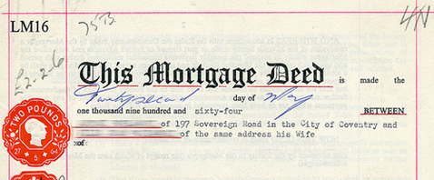
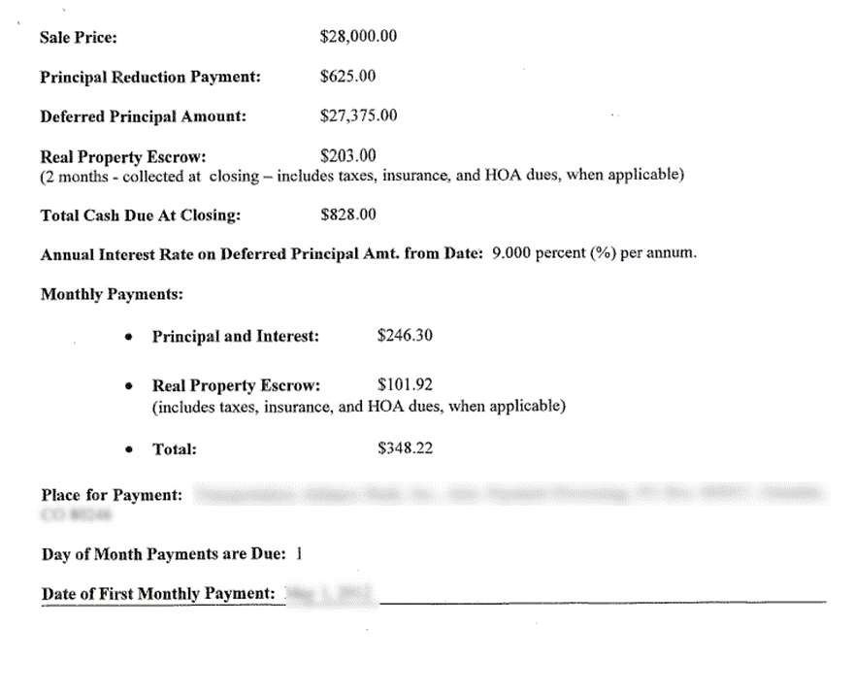
Overview
Did You Know???
Mortgages and deeds of trust SECURE the note to a piece of real estate
REMINDER: A note is NOT the same as a mortgage or deed of trust. However, most people, for simplicity, will conflate the terms.
From this point forward, I will use the terms notes, trust deeds, mortgages, loans, and liens interchangeably.
NOTE
Additional Background
Notes:
Start: {click the mouse}
So promissory notes are just that… written promises by a person or business to pay a debt over time. But what happens when that person or business can’t or won’t pay that debt? What is the recourse of the lender?
{click the mouse}
Well that’s where mortgages and deeds of trust step in.

Slide 10
Note Investing
Fun Fact; Comparisons, Advantages vs other Investments

Slide 11
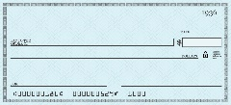
Note Investing
Did you know??
The Bank (Payee)
Payers
Fun Fact: A great majority of Americans already participate in the Note Investing Game!!
If you are paying back student loans, a credit card, a car note, or a mortgage, I’m talking about YOU!
Trouble is, that is the WRONG SIDE of Note Investing!
Stop being the PAYER… and become the PAYEE!
Become The Bank of YOU!

Slide 12
Note Investing
Real Estate Investing Landscape
Real Estate Side
Leases
Short Term Rentals
Purchases
New Construction
Fix and Flips
Banks, Hedge Funds, Corporations, Individual Investors,
Society-At-Large
“Paper” Side
Notes
Debt
Bonds
NOTES
NOTES
Banks, Hedge Funds, Individual Investors
Notes:
The underpinnings of the real estate side IS the note side

Slide 13
Note Investing
Different Types of Notes
Performing : The borrower makes his payments on time. In this case, the investor just wants a certain yield over a certain period of time. Similar to a dividend stock, CD, or savings account.
Non-Performing : The borrower has been delinquent on his payments. The amount of time of the delinquency can vary from a month to several years. Some level of work or effort is needed to rehab the assets into profits.
Re-Performing : A hybrid of the two previous types. Re-performers start off as performers, fall into delinquency, and then are able to become performing again over several payments.

Slide 14
Note Investing
How does it stack up against other passive investment types??
 | Mortgage Notes | Savings Account¹ | CDs² | Stocks (S&P 500) | Bitcoin & Digital Coins
Typical Timeframe | Variable | Variable | Variable | Variable | Variable
Tax Treatment | Taxable/Deferred/Tax-free* | Taxable | Taxable | Taxable/Deferred/Tax-free* | Taxable
Avg Annual Yield / Avg ROI | 10%+ | 0.08% | 0.7% (1 yr) 0.9% (2 yrs) | 13% (last yr) 13% (5 yrs) | -xx% to +yyy%
Investment Protection? | Yes via the Collateral Property | Insured via FDIC | Insured via FDIC | No | No
Sources:
GoBankingrates.com , July 2018
Bankrate.com, July 2018

Slide 15
Note Investing
How does it stack up against other forms of real estate investing??
Advantages
Disadvantages
Multiple ways to make money
Can have a lower cost of entry than rehabbing or rentals (California and New York investors).
Note holders are not responsible for taxes and upkeep of the property, compared with rentals*
Property destruction or damage does not necessarily impede payments or threaten the overall investment.
Better % returns requiring less day-to-day maintenance => better suited for investors with day jobs or active lives.
Because of the growing popularity of notes as an investment, in certain neighborhoods it makes more sense to buy a REO property instead of a NPN note on a similar property.
Small investors generally cannot or are not advised to use leverage to purchase note assets. Must be all cash.
Short of blatant fraud committed by a seller, note buyers may not have as much recourse against sellers.
The exact condition of the underlying property may be unknown at the time of note purchase.
Notes:
Can have a lower cost of entry than rehabbing or rentals, esp for investors from high cost states like California and New York. To buy a small house or condo to flip in Southern California nowadays in an average neighborhood will cost anywhere between $300-500k. In the Bay, probably double. So even if you use hard money and have to put down 20%, that is still $60-100k that you need to have yourself in a bank account or be able to get from some other source. And we haven’t even discussed the rehab cost or slush fund requirements the lender may want to see. Well, for folks new to the game, that’s a pretty tough hill to climb. So what I like about notes is I can get started with a fraction of that… You could find a money making note for as little as 7 to 10 thousand, maybe even less. Granted that note will never be on a house located in California but that’s ok.
Note buyers are not responsible for taxes and upkeep of the property, compared with rentals or flips… So, as we say a lot in the industry, no toilets, tenants, and trash. You don’t need to worry about the property manager or finding a good management company. Now I have an asterisk here because although technically this statement is true, a tax sale by the County (if taxes are delinquent) is one of the few things that can threaten a 1st position note investment. So you have to make sure the taxes are paid or being paid. Also, in cases where the borrower has abandoned their property or if the property has been foreclosed, the note holder IS responsible for yard upkeep and securing the property. But this is the responsibility of the owner occupant in most cases.
The exact condition of the underlying property may be unknown at time of note purchase.. That’s right. Property title or ownership isn’t changing hands here. Therefore, the note buyer doesn’t really have a right to that information. With that said, there are some ways a note buyer can gain some intel on the condition. But it is mostly under the table… Just know that a formal property inspection, which would be normally requested at origination, will not happen.

Slide 16
Non-Performing Note Investing
The Lifecycle of a NPN
Money-making Exit Strategies

Slide 17
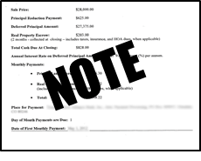
Non-performing Note Investing
The Lifecycle of a Non-Performing Note
Chris
Monthly Payments to Bank
The Bank Bundles of
Dozens of NPNs For Sale
The Bank
Jacqueline
Note Seller or Platform
Chris’s Home
Large Hedge Fund
Note Tape
Notes:
So this is the lifecycle of a NPN…
{click}
Meet Chris. {click} He bought a home in Alabama in 2012 for $55K. {click} He has a trust deed on his new home thru The Bank which is a regional bank.
{click}
Every month for several years, Chris makes payments to The Bank. However, Chris was laid off from his company. He was initially able to make the payments from savings and unemployment insurance. {click} But after awhile it becomes impossible. He stops making payments in 2015.
{click}
After some # of months, The Bank looks at its balance sheet and makes a decision. It packages Chris’s newly delinquent loan along with others in a bundle. {click} This bundle sells to a large hedge fund. {click} After parsing the best properties out of the bundle, the hedge decides to sell off most of its undesirables to a smaller hedge fund. The small hedge fund isn’t interested in any of the assets for itself. So it decides to sell off its entire bundle. {click} So it throws all of the assets onto an Excel workbook called a tape. {click} It shops this tape out to small investors like Jacqueline, who can decide to buy the entire tape or cherry pick the assets she wants.
---=--=EXTRA, with numbers =--=-=-=-=-
After some # of months, The Bank looks at its balance sheet and makes a decision. It packages Chris’s newly delinquent loan along with others in a bundle. {click} So let’s use some real numbers here. This bundle which includes $9 Million in unpaid balances sells for $3 Million to a large hedge fund. {click} After parsing the best properties out of the bundle, the hedge decides to sell off most of its undesirables (let’s say - $7 Million in total UPB) to a smaller hedge fund for $3 Million. Please note the large hedge has already recouped its cost but still has $2M in good assets left over. The small hedge fund isn’t interested in any of the assets for itself. So it decides to sell off the entire bundle subset targeting a min of 50% of the total unpaid balance value ($3.5 M). {click} So it throws all of the assets onto an Excel workbook called a tape. {click} It shops this tape out to small investors like Jacqueline, who can decide to buy the entire tape or cherry pick the assets she wants.

Slide 18
Non-performing Note Investing
How will I make money??
What are Jacqueline’s Exit Strategies once She Buys the Note on Chris’s House??
Chris
Jacqueline
Chris’s Home
Notes:
{click} Jacqueline sees Chris’s note on the tape.
She sees that it is a 2BDR, 1Bath house. The unpaid balance or UPB is $47253 with 3 years of late fees building up. The P+I payments are $325. Chris has 27 years left to go on his note.
She can buy the note for $25000. Through her due diligence on the property, she sees that the house is now worth about $60K. Similar houses rent for $750.
{click}
What are her exit strategies after she buys this note??

Slide 19
Non-performing Note Investing
Exit Strategy #1 – Loan Modification
Chris
Jacqueline
OLD NOTE
NEW NOTE
Jacqueline can approach Chris to determine his desire and ability to restart payments on a modified loan.
After agreeing to the loan mod terms, Chris is happy he gets to stay in his home and Jacqueline starts collecting payments. Jacqueline is happy that she will collect most or a good portion of Chris’s unpaid balance over time, which is a lot more than what she paid for the note.
Chris’s Home
Notes:
Exit strategy #1 – Seek a loan mod..
read {click} , {click}
read {click}
((But let’s say that she really does not want to keep the rehabbed note. She could get fancy and re-sell the NOTE on the secondary market after 6 mos or year of payments. Lots of people are out there desiring performing and re-performing notes.))
Doing a loan modification is generally considered the best case strategy for investors, especially if the property is still occupied by the borrower or if the borrower has tons of emotional equity in the home.

Slide 20
Non-performing Note Investing
Exit Strategy #2 – Chris can sign a deed-in-lieu, giving back the house to Jacqueline
Chris
Jacqueline
Now Jacqueline can do whatever she wants with the property…
-Get the house rent ready and rent out the home
-Fix up the house and put it on the market
-Do nothing. Sell the house to an investor who will fix it up
-Do little/Get the house in good enough shape to rent. Seller finance the home
Chris’s Home
Notes:
Exit strategy #2 – Chris can sign a deed in lieu.. Same as the foreclosure exit strategy except that Jacqueline’s legal fees to regain title are far less significant..
{click} , {click} (talk thru what is happening)
read {click}

Slide 21
Non-performing Note Investing
Exit Strategy #3 – Foreclose on Chris’s House
It’s been some time since Chris was either able or willing to make loan payments. Fortunately for him, no holder of his loan has ever taken action against him.
Chris
Jacqueline
Jacqueline tries to reach out to Chris to see what he wants to do. Either because of denial or embarrassment, Chris does not respond to Jacqueline’s query.
Jacqueline contacts a local lawyer to begin the foreclosure process. Fortunately for her, Chris’s loan is a deed of trust that has a power of sale clause, which means a speedier NON-JUDICIAL foreclosure.
Chris’s Home
Notes:
Exit strategy #3 – Chris gets foreclosed on..
{click} read
{click} read
{click} read
If Chris had gotten a mortgage w/o what is known as a power of sale clause instead of a TD, it is likely this would have gone thru the courts, which too is allowed in Alabama

Slide 22
Non-performing Note Investing
Exit Strategy #3 – Foreclose on Chris’s House
At the trustee sale, 1 of 3 things will likely happen
Chris
Jacqueline
1) Chris somehow comes up with the money needed to pay off Jacqueline completely (the entire unpaid balance plus fees)
2) If there are no bidders, Jacqueline takes back the property*
Chris’s Home
3) The winning bidder buys Chris’s home*
Notes:
{click} read
{click} read
{click} read
{click} read
1B scenario: Chris talks to Jacqueline and promises funds to delay the foreclosure sale. Jacqueline agrees to postpone for 30-60 days.
The asterisk means that this scenario does not take into account some states’ rights of redemption, that can further complicate an investor foreclosure. In Alabama it is a year.
If the investor cares more about capital gains or securing the property for his own portfolio, foreclosing is the best strategy

Slide 23
Actual NPN Investing Examples
Examples from Fellow Investors
My First 2 Deals

Slide 24
Actual NPN Investing Examples
Fellow Note Investor Example
SFR in Fairgrove, MI
The investor bought the note for $19K, expenses were $7K , taxes were $4K , rehab was $4K.
All-in Cost = $34K
As-is value was $60K, ARV was $120K
Home was FC’ed and became REO 6 mos after note purchase. The investor did not do much rehab here, just taking care of the most critical items to encourage a sale
After a year, the home sold for $60K on a 30 year land contract/contract for deed (9% interest rate)

Slide 25
Actual NPN Investing Examples
Fellow Note Investor Example
Mobile Home in Louisburg, NC
The investor bought the note for $4K, expenses were $2K.
All-in Cost = $6K
As-is value was $40K, ARV was $70K
Before the investor could foreclose, the borrower sent a full payoff of $12.5K, resulting in a total ROI of 100% in 4 months

Slide 26
Actual NPN Investing Examples
Fellow Note Investor Example
Unoccupied SFR in Austell, GA (CFD)
The investor bought the note for $16.5K, expenses were $5K.
All-in Cost = $21.5K
The only issue that cropped up on this one was the fact that it was in a flood zone. Held up closing for 2 months.
Here, the investor sold direct to an investor or to a handyman buyer for $52K cash
13 months from purchase to close – 146% ROI

Slide 27
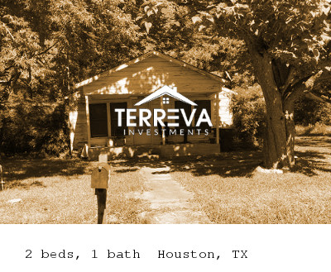
Actual NPN Investing Examples
Terrence Note Deal #1
2+1 900 sf home located in Houston, TX
Bought this note in May/June 2017 for $3K (UPB = $6K)
Payments were around $350, But had been delinquent for 4 years
The house was estimated to be worth $20-25K as-is
Since this was in Texas (fast foreclosure state), the plan was to FC and resell as REO.. Get in, get out by year’s end
My all-in cost was going to be around $11K
My gross target profit was around $9-14K, or 82% return
BUT….

Slide 28
Actual NPN Investing Examples
Terrence Note Deal #1 – THE CHALLENGES
Found out not long after I bought the note that both of the borrowers were DECEASED
Have to go thru the probate process – thru the courts
This process was estimated to take 9-12 months at least
Probate => Longer court timeline => Higher Legal Costs
My estimated legal costs of $2500 jumped to $8000
Because this cost/timeline was much larger than anticipated, I made the decision to get a JV partner to share the load.
By the time the chain of title/note assignments was changed to reflect the new JV partner, something big showed up in Houston in late August 2017…

Slide 29
Actual NPN Investing Examples
Terrence Note Deal #1 – Hurricane Harvey Hits Houston

Slide 30
Actual NPN Investing Examples
Terrence Note Deal #1 – Hurricane Aftermath and Current Status
Insurance
Unfortunately for us, we had not yet bought force place insurance to protect us in the event of a disaster. And once the hurricane was predicted to hit Houston, no further underwriting was allowed!
Fortunately for us, the hurricane did not flood the section of Houston the property was located. We found this out by sending a local investor to the house to check it out. We finally got insurance once underwriting began again.
Probate Legal
Our legal team was located in Houston. Consequently, the entire matter got delayed by 1.5 to 2 months
Current Status
As of June 2018, the probate portion is winding down. Should be done in a few months. Once probate is complete, foreclosure process can begin.
The prospects for profit are still good. It will just take a bit longer to get it.

Slide 31
Actual NPN Investing Examples
Terrence Note Deal #2
2+1 846 sf home located in Kansas City, MO
SDIRA bought this note week of July 4th, 2018 for $14K (UPB = $24229)
Projected total expenses = $4K
Payments were around $246, but has been delinquent for a year
Similar houses rent for $750
Why did I like it enough to buy it??
The type of note is a land contract or contract for deed
On the edge of a decent area.. Other 2 BDR homes can go as high as $100K. This home is valued as much as $40K as-is, $70K+ if rehabbed
My desire is to take back the property. And sell as a REO for a 100% gain.
However, I first must see what the borrower is thinking. If he or she has the income to restart the payments, I’ll have to accept a ‘mere’ 14% ROI.
Notes:
A land contract is a type of seller finance contract.
So how seller finance works is… let’s say you have a piece of property that you own free and clear. You sell it to a buyer. You are carrying back the loan. Meaning they aren’t going to a BofA to get a loan. You are extending that credit to the buyer. They would move in as normal, you would move out. They would make payments to YOU.
Ok, let’s take it a step further than that. Normally, a buyer would hold title to the property. In the case of a land contract, the SELLER retains title to the property until all payments have been made. Kinda like a car loan. So if you were to do a title search on a CFD home, the owner would be the one who is extending the credit, not the person occupying the home. In addition to that, the note & security for the loan is governed by a contract, not a traditional qualified mortgage. So, if the buyer stops paying, the seller can void the contract and fully take back the property, skipping the foreclosure process altogether. Cuts down on lawyer fees.
Land contracts are predominately used with buyers who have poor to not so great credit or otherwise who cannot go to a traditional lender.

Slide 32
Wrapping Up…
Next Steps, if interested

Slide 33
Wrapping Up
Let’s return to the opening question…. Are you satisfied with YOUR returns?
After 15 years:
The avg CD or “high-yield” savings account will have a net 16% return
A 6% ROI year-over-year will more than double your money! 10% ROI will quadruple your money!
Note investing is partly why financial institutions have prospered throughout time…
Isn’t it time that you took action to help secure your present and future?

Slide 34
Wrapping Up
Next Steps For Those Who Are Interested In Learning More Or In Investing
Ok. I’m intrigued. How do I find out more information?
Contact me to set up a 1-on-1. We can discuss any questions you have about the business. I can also point you in the direction of resources that I have learned from over the last 2 years. Trust but verify.
I think I want to do this! How do we get started?
Contact me to set up a 1-on-1. We will discuss your investing comfort level and likely source of funds. We will also discuss how JV agreements with Terreva Investments work.
I will send you an investor questionnaire (either via email or online questionnaire) that will need to be completed.
Remember, YOUR participation is passive. Within the JV agreement, I am doing all of the legwork – purchasing the lien, boarding the lien with a servicer, interaction with the borrower, working with the atty on the foreclosure (if required), working with contractors to do the rehab (if required), and working with the realtor to resell the asset. I will keep investors abreast periodically on the progress.

Slide 35
Webinar Q&A
Questions and Answers

Slide 36
Contact Me
Terrence Evans
+1 310 896 5162
Terreva-investments@outlook.com
Terreva Investments

